Slide 8
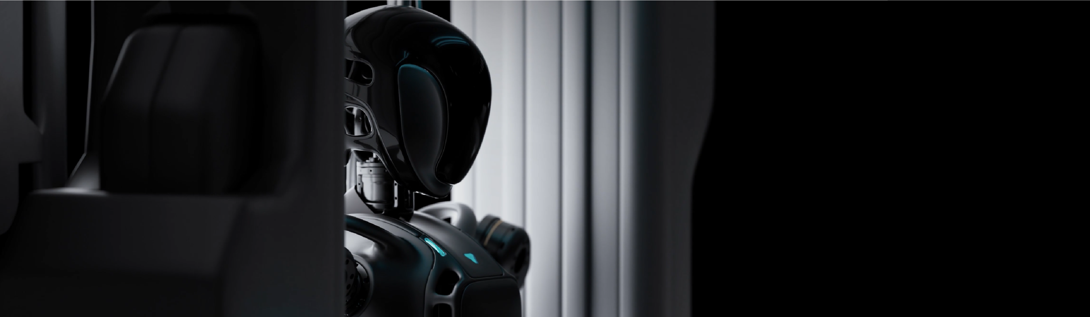


Slide 9


Slide 10
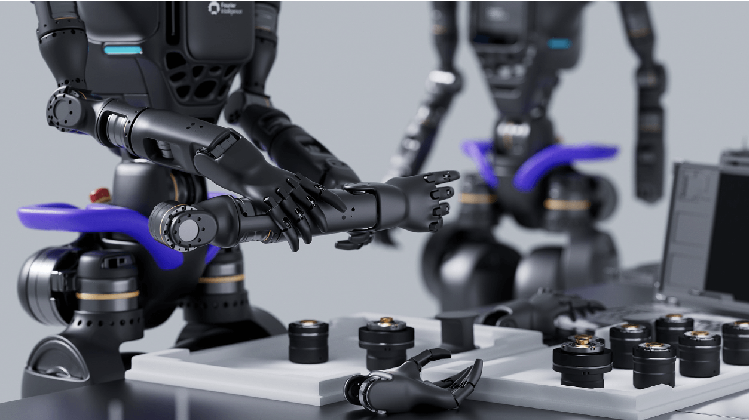

Title, Arial Bold 32pt
Subtitle, Arial Bold 18pt
Text, Arial Regular 12-16pt.
We extracted the core features of the FOURIER universal humanoid robot and created a unique F-shape, which not only highlights the industry attributes, but also conveys a professional, reliable, and technological brand atmosphere. The exclusive waist element of the brand logo GR-1 is impressive.

Slide 11
Text, Arial Regular 12-16pt.
Fourier Universal Humanoid Robot GR-1 is an independently developed humanoid robot that can be commercially mass-produced.

Slide 12
Text, Arial Regular 12-16pt.
Fourier Universal Humanoid Robot GR-1 is an independently developed humanoid robot that can be commercially mass-produced.

Slide 13
THANK YOU

